Slide 1



COOKING UP A STORM: THE RECIPE BOOK PROJECT

Slide 2
Team
NAMRATHA SRIRAM
22WH1A12C0
SAI SRIJA CHINTALAPALLI
22WH1A12B7
P.SAI MEENAKSHI REDDY
22WH1A12A7

Slide 3
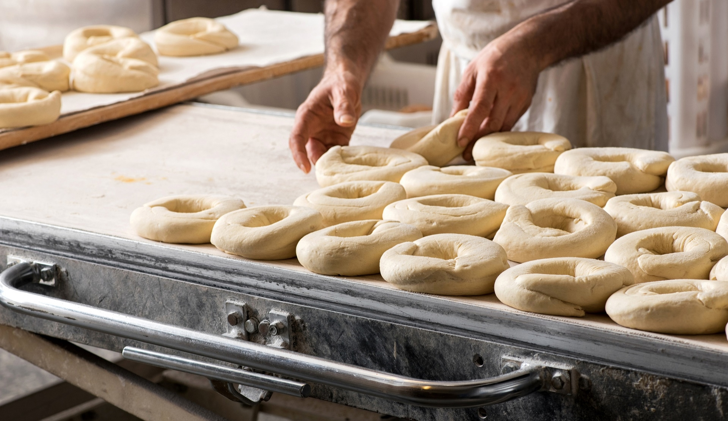
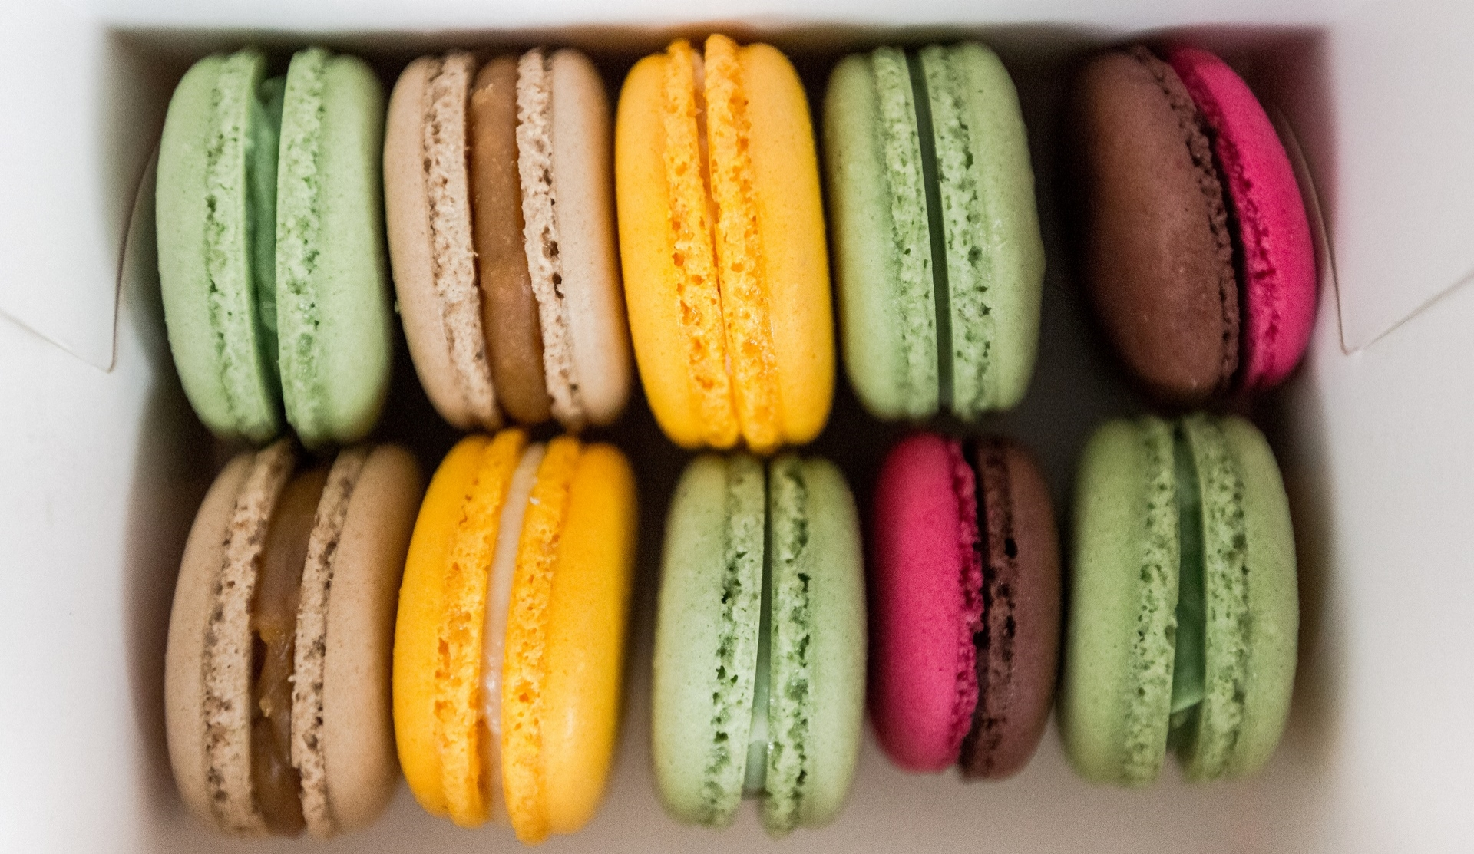
Introduction
Welcome to the presentation on our exciting new project: creating a recipe book!
Food is something that brings us all together, whether it's sharing a meal with loved ones or trying out a new restaurant with friends. And what better way to celebrate our love of food than by creating a beautiful and functional recipe book?

Slide 4

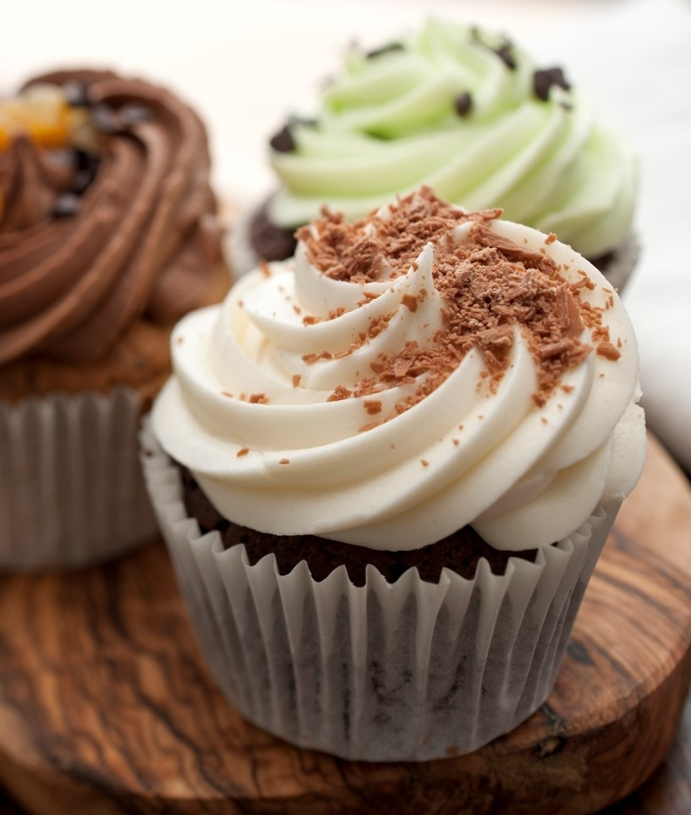
Why a Recipe Book?
A recipe book is not just a collection of recipes, but a treasure trove of memories, traditions, and culture. It's a way of preserving the flavors and stories that make our meals special. By creating a recipe book, we can pass on these culinary legacies to future generations and ensure that they are never lost or forgotten.
Documenting recipes also provides an opportunity to improve your cooking skills. As you follow and create recipes, you'll learn more about various cooking methods, flavor combinations, and presentation.
Having a recipe book can save time in the kitchen. You won't need to search for recipes online or in various cookbooks; everything you need is right at your fingertips.

Slide 5
GITHUB LINK:
https://github.com/NamrathaSriram/Projects/tree/91725f5334e27d72004ce7d47a5a288e8c20881a/now%20you%20can%20cook

Slide 6
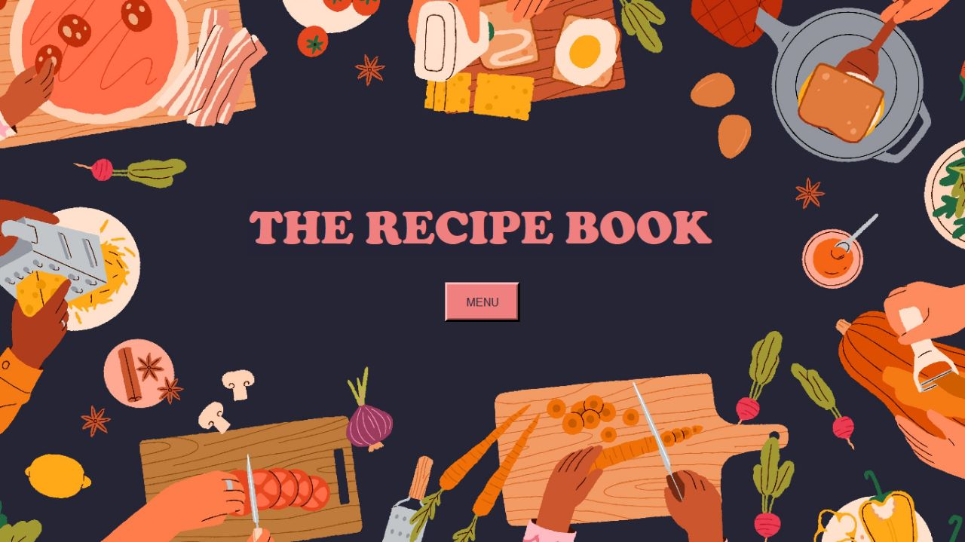
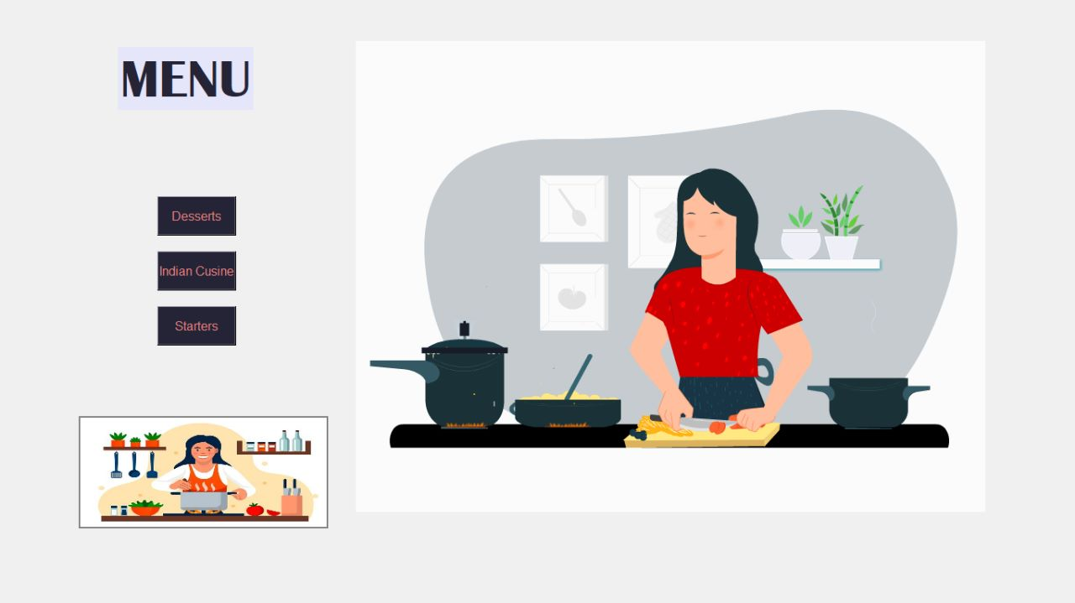
The Recipe Book:

Slide 7

Research and Planning
The research and planning phase of our recipe book project was a crucial step in ensuring that we created a high-quality product. We started by researching popular recipes online, in cookbooks
For working on our project we explored some online websites we can get the data for creating a recipe book.
We scraped the data in form of csv files from online platforms
We imported functions such as IPython, csv,re,pandas.etc
For the User Interface part we used visual studio 2022 in which we added background pictures , animations to make our presentation more effective.

Slide 8

LEARNING OUTCOMES:
Web scraping
Pillows
Pandas
Importing self made modules.
Image display through URL
Displaying Of G.I.F

Slide 9
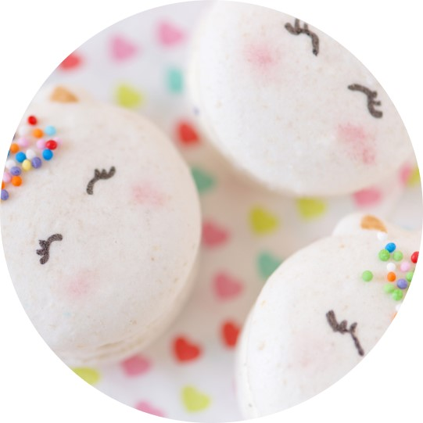
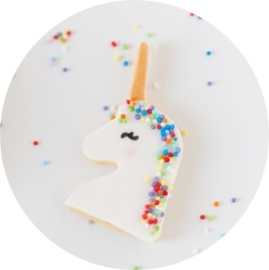
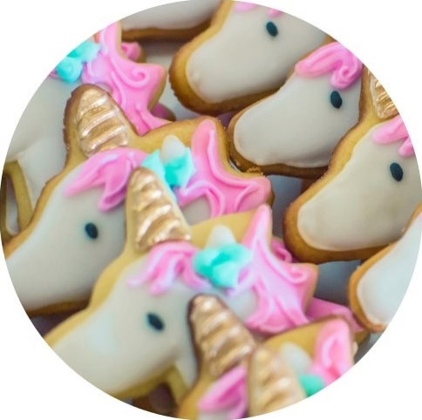
Conclusion
In conclusion, our recipe book project has been a labor of love, combining research, planning, design, and problem-solving to create a beautiful and functional book that we hope will inspire others to cook and enjoy delicious meals.

Slide 10
THANK YOU
Presenter’s roll no:
22WH1A12C0
22WH1A12A7
22WH1A12B7

